Slide 1
Hiring Process Analytics
Project Description:
As a data analyst at a multinational corporation like Google, the task at hand revolves around delving into the company's hiring process data to extract valuable insights. The hiring process stands as a pivotal function within any organization, with trends such as rejection rates, interview frequencies, job classifications, and vacancy occurrences serving as key indicators for the hiring department.
Tech-Stack Used:
Specify the software and its version (e.g., Microsoft Excel 2022) and mention the purpose of using it.

Slide 2
Problem Statements:
A. Hiring Analysis: The hiring process involves bringing new individuals into the organization for various roles.
Your Task: Determine the gender distribution of hires. How many males and females have been hired by the company?
B. Salary Analysis: The average salary is calculated by adding up the salaries of a group of employees and then dividing the total by the number of employees.
Your Task: What is the average salary offered by this company? Use Excel functions to calculate this.
C. Salary Distribution: Class intervals represent ranges of values, in this case, salary ranges. The class interval is the difference between the upper and lower limits of a class.
Your Task: Create class intervals for the salaries in the company. This will help you understand the salary distribution.
D. Departmental Analysis: Visualizing data through charts and plots is a crucial part of data analysis.
Your Task: Use a pie chart, bar graph, or any other suitable visualization to show the proportion of people working in different departments.
E. Position Tier Analysis: Different positions within a company often have different tiers or levels.
Your Task: Use a chart or graph to represent the different position tiers within the company. This will help you understand the distribution of positions across different tiers.

Slide 3
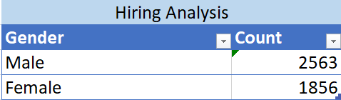
Data Analytics Tasks:
Hiring Analysis: The hiring process involves bringing new individuals into the organization for various roles.
CONCLUSION:

Slide 4

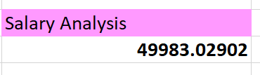
2) Salary Analysis: The average salary is calculated by adding up the salaries of a group of employees and then dividing the total by the number of employees.
CONCLUSION: The average salary is 49983.02.

Slide 5
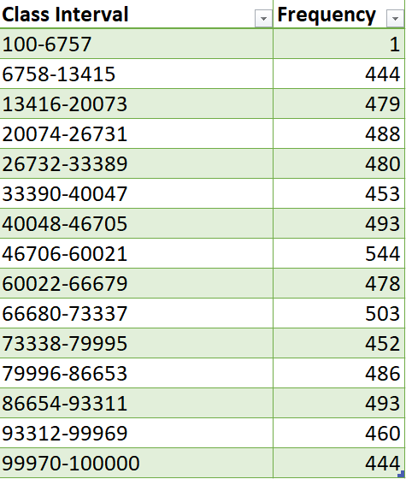
3) Salary Distribution: Class intervals represent ranges of values, in this case, salary ranges. The class interval is the difference between the upper and lower limits of a class.

Slide 6
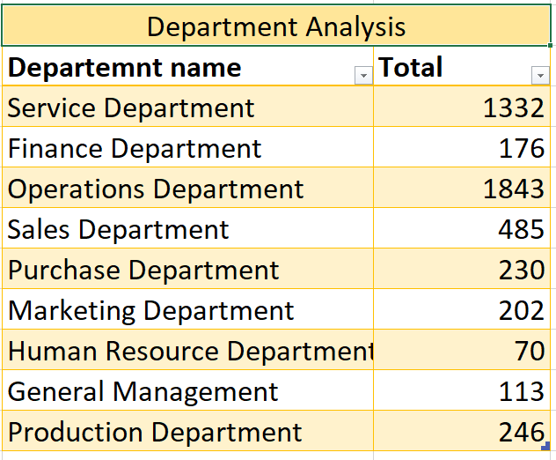
4) Departmental Analysis: Visualizing data through charts and plots is a crucial part of data analysis.
CONCLUSION: Operations department has the highest number of employees.

Slide 8

5) Position Tier Analysis: Different positions within a company often have different tiers or levels.
CONCLUSION: Post c9 and c5 has the highest count of 1792 and 1747 respectively.

Slide 9
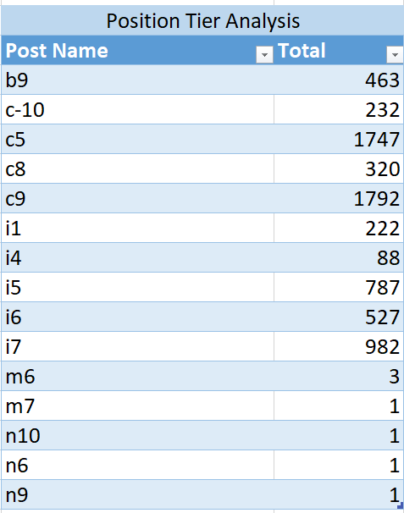
Google drive link for updated and edited Excel sheet:
https://docs.google.com/spreadsheets/d/1PL83WX8Uf0za3s5bD43IDHnkGI6D8PpF/edit?usp=sharing&ouid=105086523777475951343&rtpof=true&sd=true
Or
Statistics.xlsx

